Slide 1

“Intercultural Awareness and Cultural Diversity”
LORD BUDDHA EDUCATION FOUNDATION
ERA002-3-1
Credit Value : 3

Slide 2
Unit – (01) Introduction to Intercultural Awareness and Cultural Diversity module
This module will use MOOC as the platform of teaching delivery.

Slide 3

This module describes concepts and theories related to culture including language, diversity, and identity in cross-cultural communication settings through investigating various cultural practices and values for intercultural competence and an appreciation of cultural diversity.

Slide 4
TOPICS TO BE COVERED
Introduction to Intercultural Awareness and Cultural Diversity module
What is culture? Concepts of culture. Approaches in defining culture
Dimensions of culture - cultural distances between countries: identity, power, gender, uncertainty, time and gratification of needs
Cultural taxonomies. A critical approach to cultural taxonomies
World Values Survey
Understanding Ethnic and cultural diversity - multicultural citizenship and ethnic identity

Slide 5
TOPICS TO BE COVERED
Linguistic barriers as hidden dimensions of culture
Understanding gender and gender roles in different cultural contexts
European identity and European values - Unity in diversity
Europe 2020: the current state of EU identity and diversity
European identity and values reflected in culture
Europe’s intercultural HQ: report from Brussels

Slide 6
TOPICS TO BE COVERED
Introduction to the communication studies
Intercultural communication: culture as a frame for communication
Culture matters: the role of cultural factors in intercultural communication
Business etiquette and protocol: Do’s and Don’ts when conducting business in specific
Effective strategies for working in multicultural business environments
Summary session on the IACD MOOC
Tutorial: Creating a Digital Story

Slide 7
References
Essential Reading:
Neuliep, J.W. (2017), Intercultural Communication: A Contextual Approach, 7th Ed. Sage Publication, USA. ISBN 10: 1506315135 ⁄ ISBN 13: 9781506315133
Martin, J. and Nakayama, T.K. (2018), Intercultural Communication in Contexts, Mc Graw-Hill International Edition, USA. ISBN10: 0073523933 | ISBN13:9780073523934
Wilce, J.M. (2017) Cultures and Communication: an Introduction; University of Cambridge Press, Cambridge. ISBN-9781107628816

Slide 8
Assessment Percentage (%)
Top priority in CA/CT to active Participants and discipline
Continuous Assessment
Class test (20%)
Final Assessment
Individual Reflective Report (1000 words) (20%)
Individual Digital Story (3 minutes) (60%)

Slide 9

Asia Pacific University of Technology & Innovation (APU) Jalan Teknologi 5, Taman Teknologi Malaysia, 57000 Kuala Lumpur, Wilayah Persekutuan Kuala Lumpur, Malaysia

Slide 10


Chapter – (02) What is culture? Concepts of culture. Approaches in defining culture

Slide 11

What is Culture ?
It is sensitivity and understanding of our response to people who have different traditions, values, customs, behavior, standards, attitude and norms

Slide 12
Definitions of Culture
“Culture consists of the unwritten rules of the social game. It is the collective programming of the mind that distinguishes the members of one group or category of people from others” (Hofstede, Hofstede & Minkov, 2010).
“The system of shared beliefs, values, customs, behaviours, and artifacts that the members of society use to cope with their world and with one another, and that are transmitted from generation to generation through learning” (Bates & Plog, 1990).

Slide 13
A Globalising World
Technological advancement
Innovations
Intensified process of integration and interaction between national economies, businesses, people and cultures
Intense process of intercultural communication

Slide 14
Conceptialising Culture
Centuries ago, culture was associated with cultivation of agriculture, which later transformed into a meaning related to the connection of people with nature, then further in time, culture was used to refer to cultivating the mind (Petrina, 2009).
The early 19th century school of evolutionism in anthropology suggested the first formal definition of culture by Edward Tylor, as a “complex whole which includes knowledge, belief, art, morals, law, custom and any other capabilities and habits acquired by man as a member of society”. Cultural traits were understood as representing the ethnocentric views of the mental and moral progress in the rational society of the industrialising England.
Franz Boas, an early 20th century anthropologist introduced the views of cultural relativism, seeing culture and human behaviour as conditioned and acquired solely through unconscious learning (learning without awareness), based on the postulation (Assumption) that all cultures are equally developed according to their own priorities and values; none is better, more advanced, or less primitive (Pracheen) than any other.

Slide 15
The Modern Concept
Schwartz (1992) suggests that human behaviour can be understood through culture as a collective phenomenon which includes language and the symbolic codes adopted by people, and consists of learnt behaviours which are transmitted from generation to generation within a particular cultural group.
Hofstede, Hofstede and Minkov (2010) maintain that “Culture is learned, not innate” and it is fundamentally shaped by people’s social environment, bridging human nature and individual’s personality, although an exact differentiation between the tree components cannot be provided by social sciences yet.

Slide 16
The Main Characteristics of Culture
Culture is shared – it is studied in relation to groups of people (nations, tribes, ethnic groups). An individual does have a personality but not an individual culture. Individuals within a specific group usually share similar values, norms and beliefs. It should be noted that not all group members necessarily hold the same cultural traits.
Culture is stable – some cultural traits can be durable and stable throughout centuries, such as religious beliefs, saving money and resources, while others can change faster as a result from a particular economic situation – e.g. languages or partial convergence of foods and clothing around the globe.
Culture is symbolic – cultural traits assume various forms from material objects, houses, pieces of art, patterns of behaviour, family relationships, economic activities, and legal sanctions, to language and beliefs, which represents specific symbols and as such express meaning.

Slide 17
Culture is continuous
It is continuous process. It is like a stream which is flowing from one generation to another through centuries. “Culture is the memory of human race.”
Culture is learned
Culture is not inherited biologically but it is leant socially by man in a society. It is not an inborn tendency but acquired by man from the association of others, e.g. drinking, eating, dressing, walking, behaving, reading are all learnt by man.
Culture is social
It is not an individual phenomena but it is the product of society. It develops in the society through social interaction. It is shared by the man of society No man can acquire it without the association of others. Man is man only among men. It helps to develop qualities of human beings in a social environment. Deprivation of a man from his company is the deprivation of human qualities.

Slide 18
ICC Key Skills
Empathy
Respect
Tolerance
Sensitivity
Flexibility

Slide 19
Why are Cultures Different?
Different solutions to perhaps similar problems
Forces resulting in cultural differences (interrelated):
History
Ecology (the environment)
Technology
Biology
Institutional Networks
Interpersonal Communication Patterns

Slide 20

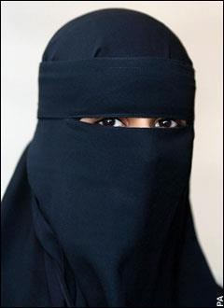
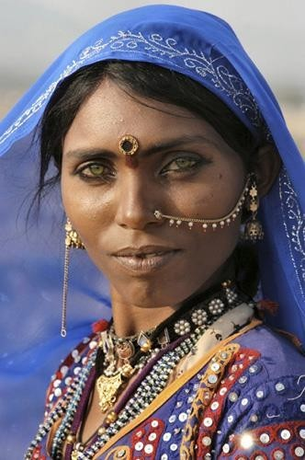
Cross Cultural Research – Comparing Nations and Their Cultures

Slide 21
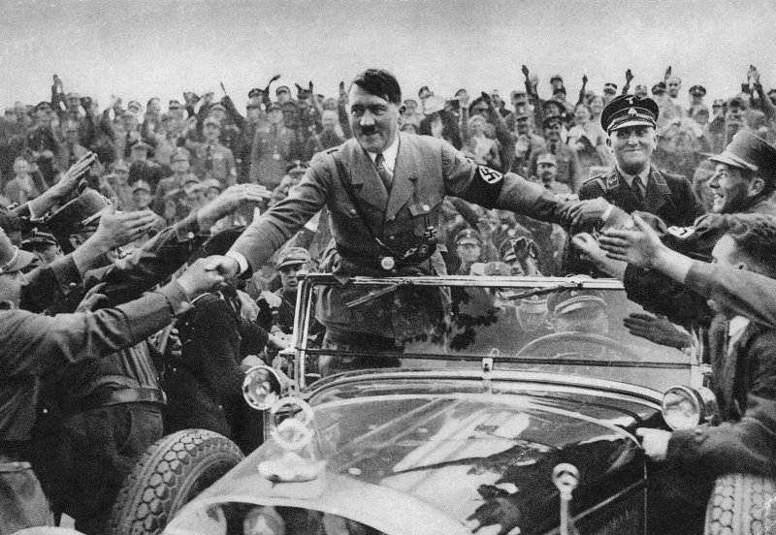
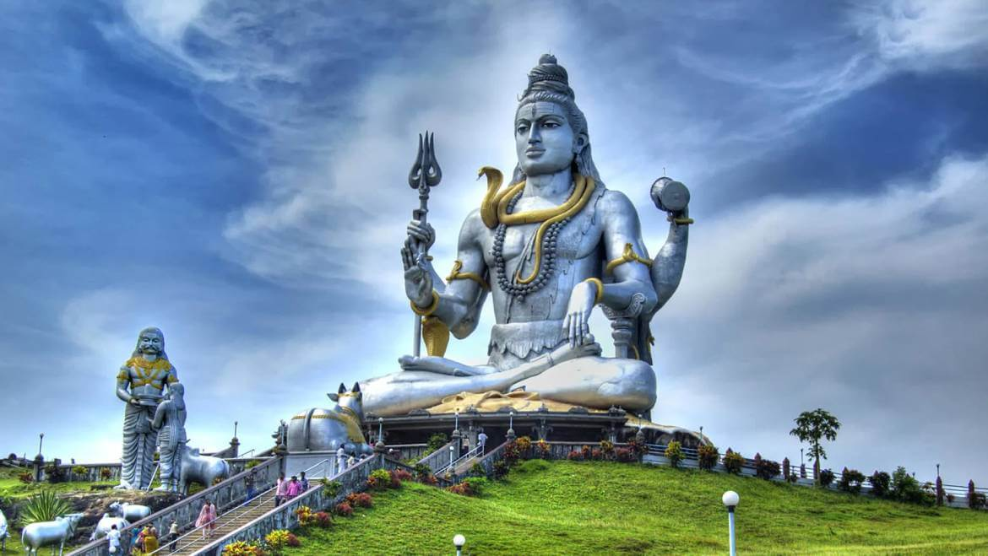
Why are Cultures Different?
History
Wars, major events, historical leaders, system of power, legislation (Kaanoon), religious practices…
“You have to know what people have been through to understand what they want and what they don’t want…” (McCullough in Lusting and Koester, 2013, p34)

Slide 22
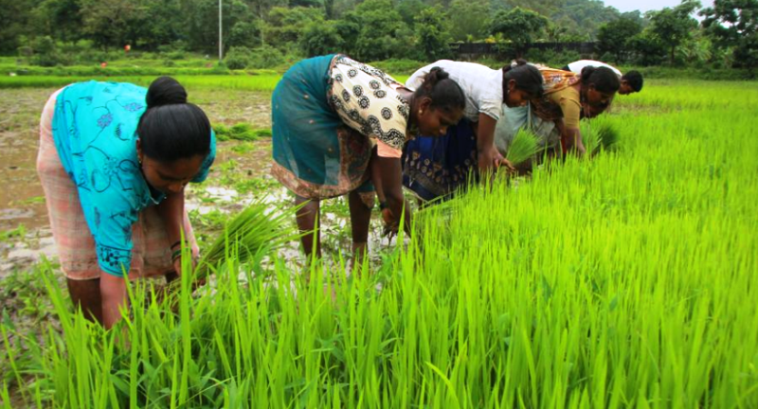
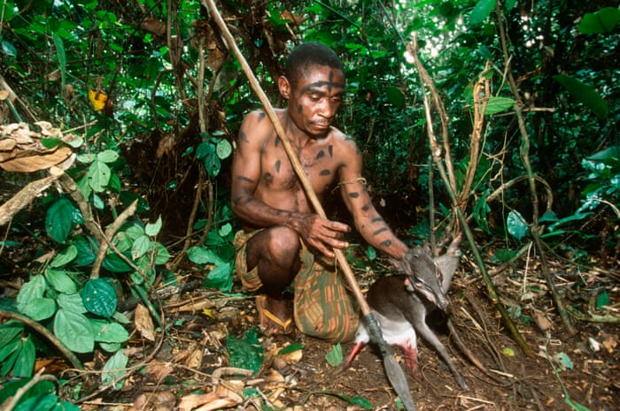
Why are Cultures Different?
2. Ecology
Weather conditions, water supply, geography of the area, scarcity= (lack) of resources
Agriculture Hunting

Slide 23



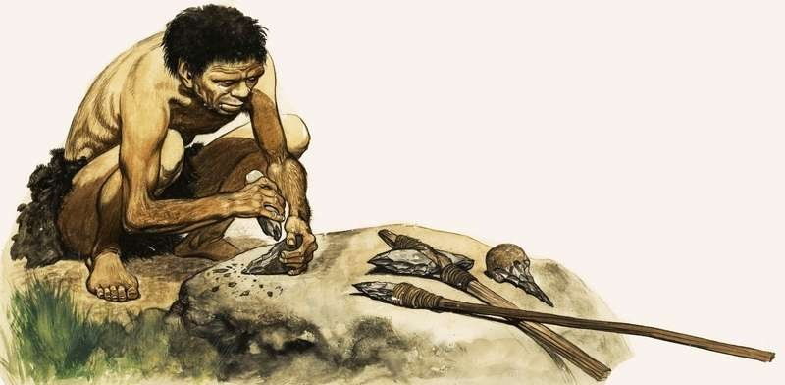
Why are Cultures Different?
3. Technology
Tools, media, phones, computers…
Adaptations to cope with / utilise a new piece of technology.
More individualism? (your own phone, TV, car…)

Slide 24

Why are Cultures Different?
4. Biology
Controversial! Genetic differences do exist but cultural learning or/and environmental forces are reasons for distinctions between human groups.

Slide 25
Me, Myself and I – The Concept of Identity
A fixed system of beliefs about ourselves based on recollection of knowledge learnt
through previous experiences in a particular cultural environment (Campbel, Assenand, & Di Paula, 2000).
The knowledge of own qualities is organised in a schema which guides our behaviour and style of communication (Trenholm & Jensen, 2011).
Communication shapes the individual “Me” in accordance with the social expectations and the adopted rules of behaviour.
The “I” represents the desire to declare one’s ego. If the “I” fails to comply with the
social regulations, then the “Me” reminds us about the required norms of behaviour (Mead, 1962).
“I” and “Me” merge into “Myself” as an important construct of our self-concept, thus
the representation of one’s identity should involve his/her individual, interpersonal and group Self.
The complex nature of people’s identities can cause serious confusion and
misunderstanding due to significant cultural differences in perception of self (Gudykunst & Kim, 1992).

Slide 26
My Multicultural Self
Write your name in the centre of the figure. Fill in each of the 5 circles with the
5 most characteristic and important
values in defining yourself (group membership, gender, age, language, physical or mental abilities, ethnicity, social status, ethnicity, religion, political views, geography, nationality…)
This activity is suggested to help you get a deeper understanding of your own perception of self and the aspects of your multicultural identity. You may choose to share and compare the information with your family members, friends, teachers or co-workers. At the end of this course, after having gained sufficient knowledge about cultural differences, you can reflect on the factors which may have affected your cultural identity and perception of self, as well as on what makes you different or similar to the members of a particular cultural group and how these differences and similarities may affect your interaction in multicultural education and business environment.

Slide 27
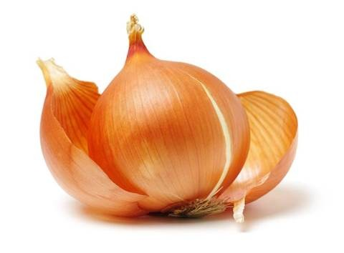

Slide 28
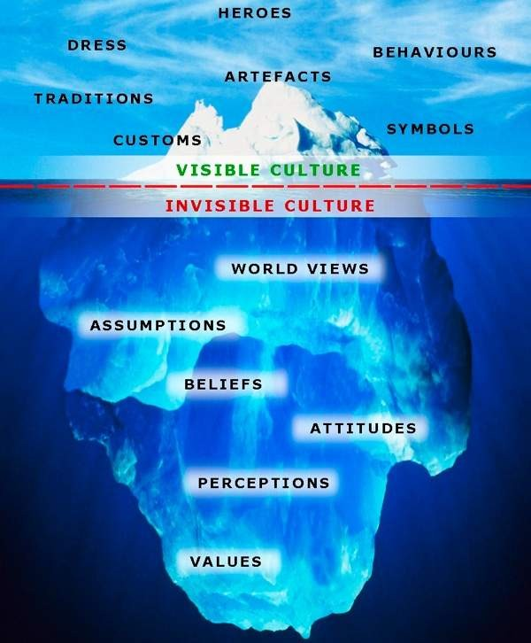
The Iceberg Model of Culture
The Iceberg Model. Retrieved from http://civet.dedi.velay.greta.fr/book/export/html/36

Slide 29
The Iceberg Model of Culture illustrates the visible (objective) and invisible (subjective) aspects of culture which affect human life in both conscious and subconscious way.
It is much easier to recognise the visible, physical expression of greetings, food, language or religion, however, misunderstanding the less visible psychological attitudes, values and beliefs can act as stumbling blocks in intercultural communication.

Slide 30
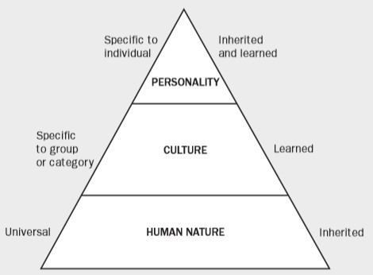
Three Levels of Uniqueness in Mental Programming
“Three levels of uniqueness in mental programming”. Reprined from Hofstede, G., Hofstede G. J., & Minkov, M. (2010, p. 6). Cultures and organizations: Software of the mind. Revised and Expanded 3rd Edition. New York: McGraw-Hill.

Slide 31
Culture as a Complex System
A complex system of shared values and beliefs giving people a sense of belonging or identity through:
Language and communication
History and geography
Arts and traditions
Beliefs and religion
Food and cuisine
Architecture
Ceremonies and festivals
Nonverbal communication and body language
Business etiquette
Leadership styles
Personal goals and incentives

Slide 32
Can Culture be Measured?
Working and studying with people from diverse cultures requires an understanding of participants’ social values of status, respect, love and service, attitudes to in-group and out-group, perceptions of means for control (shame and guilt), of individual growth, competition, self-reliance (Aatmnirbharta) and self-awareness.
There exist plenty (enough) of subjective views and definitions based on qualitative interpretation (Explanation), however the best approach to understanding the meaning of culture relies on objective scientific methods used for measuring the elements of culture.

Slide 33
The Measurable Elements of Culture
Values – personally important factors, such as religion, work, leisure (Holidays) or fame. Empirical research has revealed significant differences between cultural values hold by people in different parts of the world.
Norms – what should people do or not do. Attitudes to rules and regulations can control and restrain one’s behaviour and desires for gratification of personal needs, however science suggests that norms are values which are more commonly prescribed to others rather than to ourselves.
Beliefs – what is considered true or false in a particular society can affect social organisation and the social roles of the individual. Women should look after children and keep the household while man should earn the family living.

Slide 34
Attitudes and judgments – what do people like or dislike, what is good or bad, what we think of someone or something…
Self-perceptions – how happy people are with their own social relationships, well- being, health, political views…
Cognitive ability – usually measured through IQ tests. At national level the results can be used to measure a country’s competitiveness and globalisation challenges.

Slide 35
Behaviors – comparison of different national statistics, such as consumption of alcohol and tobacco, can provide important cross-cultural information.
Stereotypes – generalized descriptions of societies and people in them which help to categorize things, events and people and make sense of the world around us (Asians are good at math, Africans are good athletes, all Germans are engineers). Negative stereotypes however can hinder (interrupt) open communication and lead to a wrong perception of "us and them" or in-groups and out-groups.

Slide 36
Class Assessment Activity – (02)
Draft a short cultural guide for a group of international students who are planning to visit your country for a month. Include some information related to:
Geography, history, climate
Economy and business
Political structure
Language
Religious beliefs
Ethnic groups
Gender equality
Negotiations
Communication with co-workers
System of education
Style of communication– greetings, gestures, formality
Gift giving
Entertaining, food, going out with friends
Business etiquette
Leadership and management style
(1000) Words

Slide 37
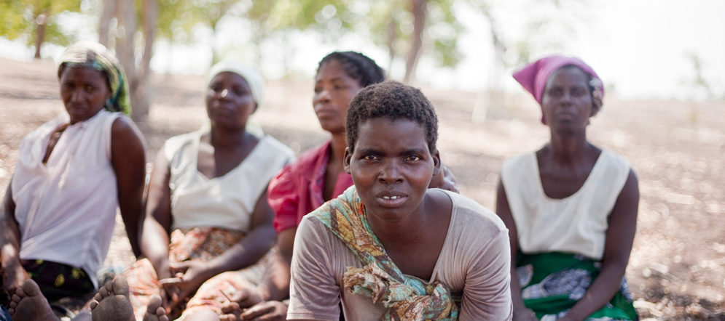
CHAPTER- 02 AND “UNIT-03”
Dimensions of culture - cultural distances between countries: identity, power, gender, uncertainty, time and gratification of needs

Slide 38
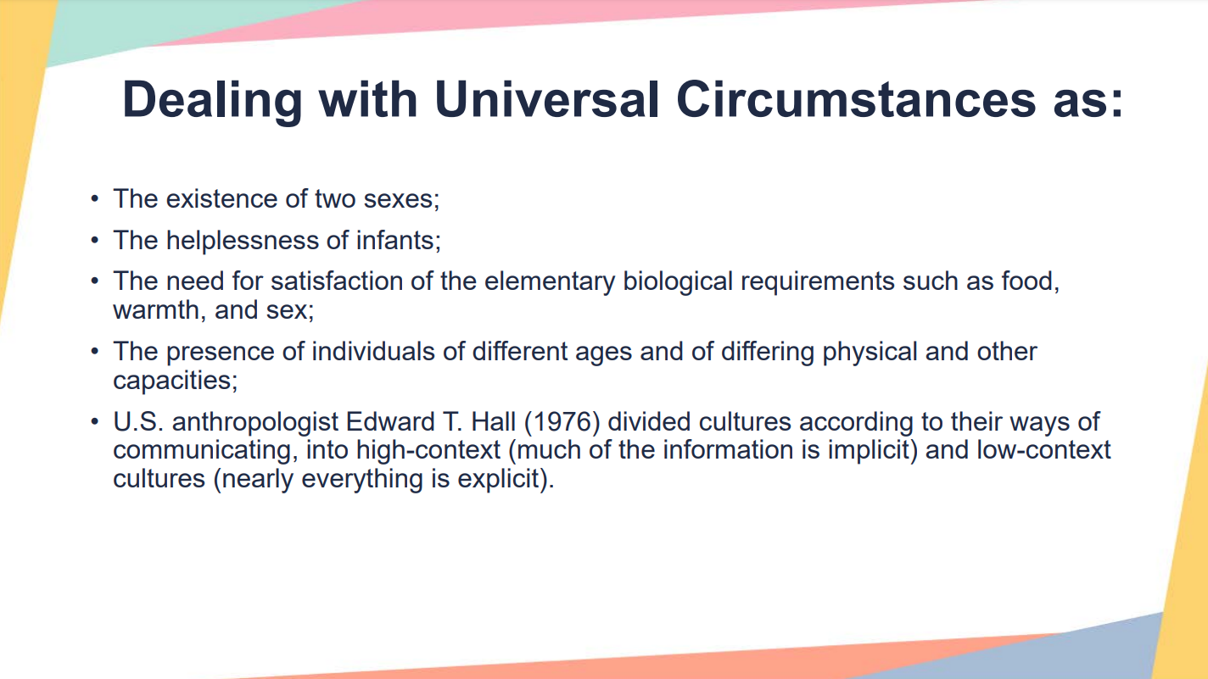
Unclear
Clear

Slide 39
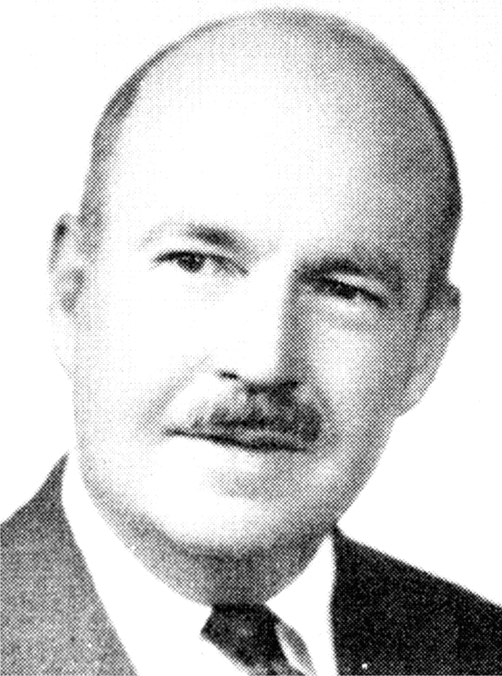
Five Pattern Variables
U.S. sociologists Talcott Parsons and Edward Shils (1951, p. 77) suggested that all human action is determined by five pattern variables, which are as pairs of alternatives:
PARSON'S PATTERN VARIABLES
Talcott Pearson is considered as one of the founding fathers of sociology, he developed a theory of pattern variables refers to a dichotomy (divided in parts) that describes alternatives of actions between which each person or group has to choose in every situation. The actions are shaped by three systems;
1. The personality system.
2. The cultural system. and
3. The social system.
1902-1979
American Sociologists
Talcott Parsons

Slide 40
Five Pattern Variables
AFFECTIVITY/AFFECTIVE NEUTRALITY: Emotional impulses are gratified e.g. a child is allowed to show love for his parents.
Affective Neutrality; Emotional impulses are inhibited e.g. a bureaucrat (Boss) in an organization or a teacher grading papers, it is expected to be emotionally neutral.
2. SELF-ORIENTATION/COLLECTIVITY ORIENTATION: In self-orientation, action is based on the actors own self interest, needs and goals e.g. a student decide what to study in college based on his/her own interest.
Collectivity Orientation; action is based on what is best for the collectivity e.g. a child quit school to work to support the family.
3. UNIVERSALISM/PARTICULARISM: Universalism connotes actions are based on general standards or universal law and moral goods e.g. the Supreme Court decide cases according to rules valid for the whole community.

Slide 41
Particularism; actions are based on the priority & attachment that actors play in the relationship at situation e.g. you gives support to a friend without considering whether he is right or wrong.
4. ASCRIPTION/ACHIEVEMENT: In the process of ascription, action is based on given attributes (race, sex, age) for instance, being eligible for the draft or allowed to buy alcohol or vote because you are within a specified age.
Achievement; action is based on performance e.g. graduation from college based on completion of the requirement.
5. SPECIFICITY/DIFFUSENESS: In specifity, action is based on specific criteria or roles e.g. clerk/customer role, teacher/student role, there are narrowly and defined
Diffuseness; open guidelines for action e.g. becoming friends with teachers, going beyond the clear boundaries of teachers/students.

Slide 42
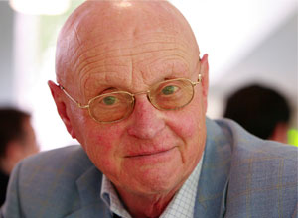
Geert Hofstede
Geert Hofstede, (born 2 October 1928 in Haarlem, Netherlands) is an influential Dutch researcher in the fields of organisational studies, organisational culture, cultural economics and management. He is a well-known pioneer in his research of cross-cultural groups and organisations.

Slide 43
Chapter 2: What is culture? The
concept of culture. Cultural theories.
Unit 4: Cultural Taxonomies. A Critical Approach to
Cultural Taxonomies

Slide 44
DIMENSIONS OF HOFSTEDE’S FRAMEWORK OF ASSESSING CULTURE
Low and high power distance
Individual and collectivism
Masculinity v/s femininity
Uncertainty avoidance
Long and short term orientation

Slide 45

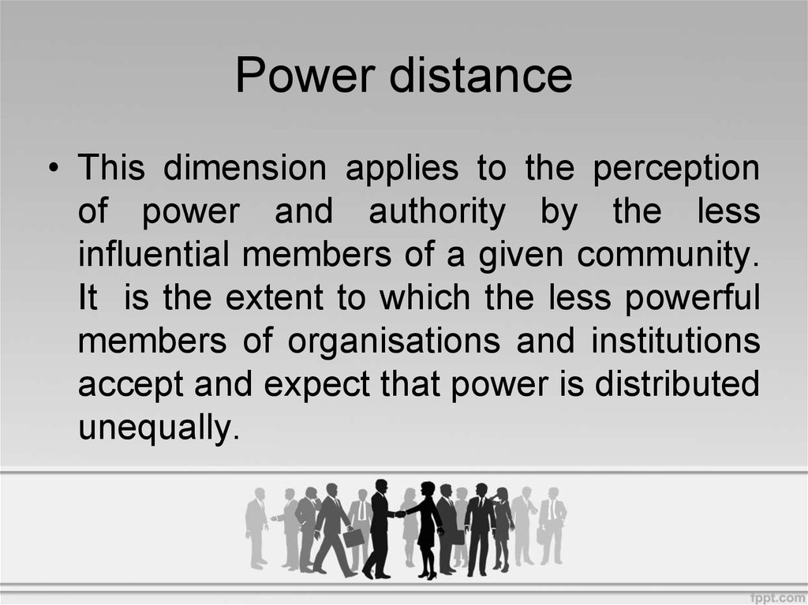


Slide 46
LOW AND HIGH POWER DISTACE
Power distance: Unequal power of distribution
High power distance | low power distance
Countries in which people blindly obey the order of their superior employees, Acknowledge the boss’s authority simply by respecting that individual’s formal position in the hierarchy and they seldom bypass the chain of command | Countries which people (supervisors and sub ordinates) are adopted to regard one another equal in power
Result
Less harmony (Peacefulness) and less cooperation | More harmony and cooperation
Centralized order | Decentralized structure
Autocratic leadership | Democratic leadership
Taller organizational structure | Flatter organization structure
Mexico, south Korea and india | Austria, Israel, USA, UK and Denmark

Slide 47
Uncertainty Avoidance
Uncertainty avoidance is a cross cultural phenomenon that describes how different cultures or societies react to and tolerate uncertainties. More specifically, it refers to how communities cope with unpredictability and uncertainty that are evident in the major aspects of governance

Slide 48
UNCERTAINTY AVOIDANCE
Uncertainty avoidance
High uncertainty avoidance | Low uncertainty avoidance
Countries with a high level of uncertainty avoidance tend to have strict lows and procedures to which people adhere closely, and there is strong sense of nationalism. In a business context this value results in formal rules and procedure designed to provide more security and greater career stability | in countries with lower level of uncertainty avoidance nationalism is less pronounced , and protests and other such activities are tolerated. As a consequences, company activities are less structured and less formal
Result
Managers have low propensity for low risk decisions (Manager takes less risk) | Managers takes more risk and there is high job mobility (Asthirta)
Employees exhibit little aggressiveness | People have risk taking attitude and high labor turnover (Workers leaves)
Lifetime employment is common | Flatter organizational structure
Taller organizational structure
Japan, Israel, Austria and Pakistan | India, USA, UK etc.

Slide 49
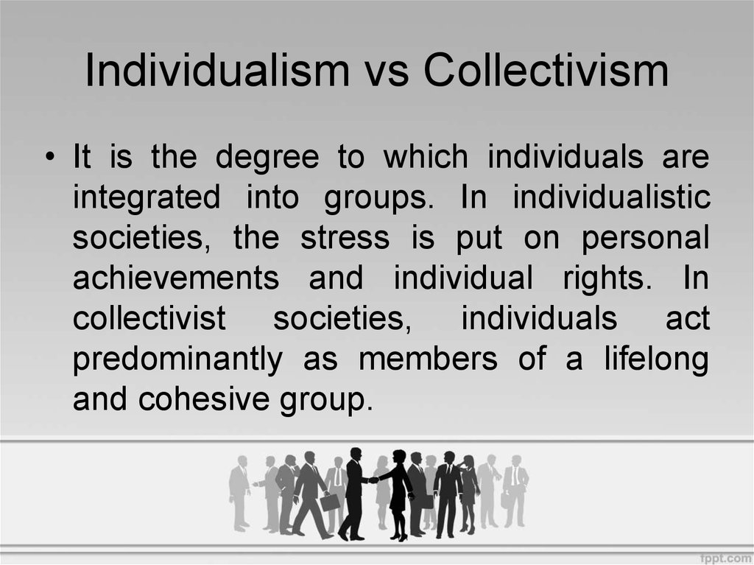

Importantly

Slide 50
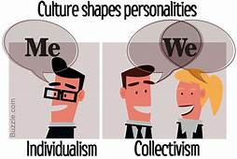
INDIVIDUAL AND COLLECTIVISM
Individual and collectivism
Individual | Collectivism
Interest of self and family “I” consciousness independence of individual from organization Greater individual initiatives Promotion are based on merit and performance | Interest of group “we” consciousness dependency on organization Less individual initiatives Promotion are seniority based
USA, UK and Australia | Japan, Taiwan and Pakistan

Slide 51
Masculinity vs Femininity
Masculine cultures value success, money and material possessions, whereas feminine cultures place more value on relationships and quality of life. In masculine cultures, the differences between gender roles are more rigid and less fluid than in feminine cultures.
Interestingly, masculine cultures are those that used to be at war often, while feminine cultures are those in which men and women had to support each other in order to persevere in harsh life conditions.

Slide 52
Masculinity vs Femininity
Typical opinions of people from a masculine culture | Typical opinions of people from a feminine culture
Men’s role is to rule, women’s role is to raise up children. | Men are also involved in children’s upbringing.
Gender roles are explicit (Clear) and concrete (Hard). | Gender roles are interchangeable.
Men should dominate (lead) in a society. | Genders should be treated equally.
Independence is the highest ideal. | Mutual dependence is the highest ideal.
People who achieve success are worthy of admiration. (Tanzania tribes wedding) | People who handle adversity deserve appreciation.
Ambitions leadership to action. | Service is the greatest motivator to action.
The great and the fast are beautiful. | The little and the slow are beautiful.
You live to work. | You work to live.

Slide 53
Long vs. Short Term Orientation
This distinction was added as the last one to Hofstede’s typology. It describes society's time perspective. Long term oriented societies attach more importance to the future. In short term oriented societies, the past and the present are more valued.

Slide 54
Long vs. Short Term Orientation
Typical opinions of people from long term orientation culture | Typical opinions of people from short term orientation culture
Tradition needs to be adjusted to the present conditions. | Respect for tradition
Frugality (savings), even meanness | A need to behave as others do regardless of consequences (Result)
Expecting delayed gratification (Can wait for satisficed result) | Expecting immediate gratification (believe in immediate satisfied result)
Importance of preserving one’s own face | Do anything to achieve a goal
Saving for future investments | No money saved for investments
Fulfilling social obligations within reason (Limited) | Fulfilling social obligations no matter the cost

Slide 55
Indulgence versus Restraint (IND)
• Indulgence stands for a society that allows relatively free gratification of basic and natural human drives related to enjoying life and having fun.
• Restraint stands for a society that suppresses gratification of needs and regulates it by means of strict social norms.

Slide 56
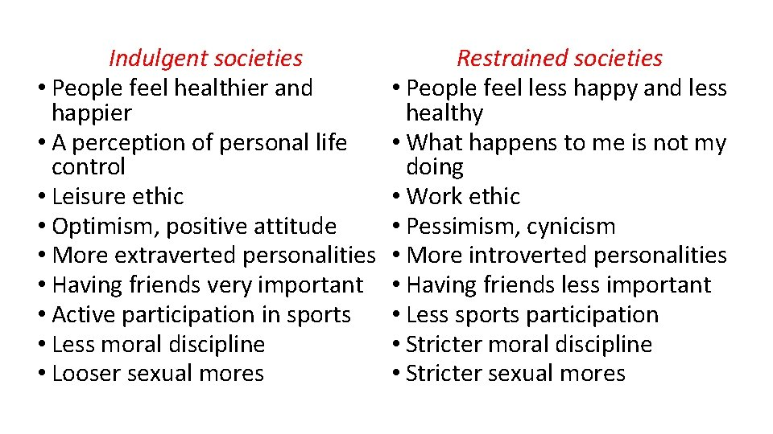

Slide 57
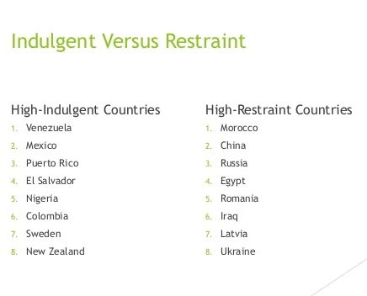

Slide 58
Interdependence of cultural dimensions
• Generally, the more individualistic a culture is, the lower it measures in power distance.
• The more industrialized a nation is, the more individualistic its members are.
• Many scholars argue that IDV is the fundamental, most distinctive cultural value by which cultural differences can be explained

Slide 59
Class Activity 3
1. In which country do people have to be most loyal to the group?
South Korea
The UK
Hungary
2. Being proud of yourself is called:
Monumentalism
Flexibility
3. Which cultural group is happier?
Latin America
East Asia
4. The cultural dimension “Power Distance” is related to the different solutions to the basic problem of human inequality.
True
False
5. If you are from Long-Term Oriented society, you should:
Avoid talking too much about yourself.
Be less willing to compromise.
Not behave in a modest way.

Slide 60
Watch the ten-minute video series with Geert Hofstede presenting the six dimensions of Hofstede model: https://geerthofstede.com/training-consulting/onlinelectures/

Slide 61
2. Complete the short questionnaire that follows. Choose one correct answer.
Which of the following statements applies to Large Power Distance?
• A. Children should learn to be independent.
• B. Subordinates expect to be told what to do.
• C. Inequality is wrong.

Slide 62
Which of the following countries are with high Uncertainty Avoidance index? (please choose the 3 relevant)
• Russia
• Arab ctrs
• U.S.A.
• India
• Mexico

Slide 63
Please connect the term to its description:
• Masculinity: A society in which emotional gender roles are distinct: men should be assertive, tough and focused on material success, women on the quality of life
• Femininity: A society in which emotional gender roles overlap: both men and women are supposed to be modest, tender, and focused on the quality of life

Slide 64
Which of the following statements refer to the Long-Term oriented societies? (please choose 3 relevant)
• Secondary school students perform well at mathematics
• Secondary school students underrate own math results
• Large savings quote, funds available for investment
• Small savings quote, little money for investment
• Companies report quarterly results, stress bottom line
• Investors prefer shares and mutual funds

Slide 65
Which of the following statements refer to the Restrained societies? (please choose 3 relevant)
What happens to me is not my doing
Work ethic
Pessimism, cynicism
Optimism, positive attitude
More extraverted personalities
Having friends very important

Slide 66
References
• Hofstede, G., Hofstede G. J., & Minkov, M. (2010). Cultures and organizations: Software of the mind. Revised and Expanded 3rd Edition. New York: McGraw-Hill.
• Hofstede, G. (2001). Culture’s consequences: Comparing values, behaviors, institutions, and organizations across nations. Thousand Oaks, CA: Sage Publications.
• Geert Hofstede (n.d.). Training/consulting. Available at http://geerthofstede.com/research-and-vsm/

Slide 67


Chapter 2: What is culture? The concept of culture. Cultural theories.
Unit 5: World Values Survey

Slide 68

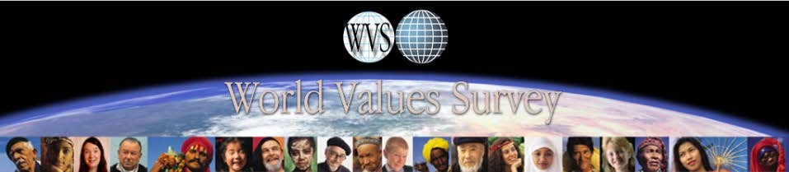
The Change of Cultural Values
www.worldvaluessurvey.org

Slide 69
Nationally representative samples (1000-3000 per nation) Nearly 100 nations studies
Surveys of values (Thing important in life), beliefs (What you believe), norms (Rules of behavior), attitudes (What you like dislike) Latest data: 1994-2004 and 2005-2008 2011-2014

Slide 70
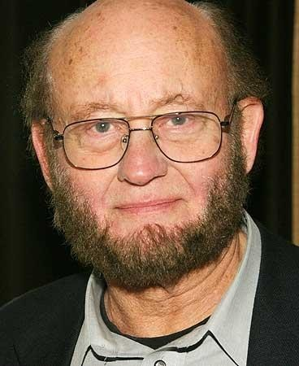
Ronald Inglehart
founder of the World Value Survey
Has studied nationally samples from almost 100
countries since 1980.
representative
Largest cross-cultural study ever, constantly updated.
Two dimensions of national culture.

Slide 71
Inglehart’s Items
(Inglehart & Baker, 2000)
Traditional
Importance of God
Child must learn faith and obedience, not independence and determination
Abortion never justifiable
Very proud of one’s nation
More respect for authority
Survival
Fighting inflation and order in the nation more important than power to the people and freedom of speech
Not very happy
Has not signed a petition
Homosexuality never justifiable
No trust in people

Slide 72
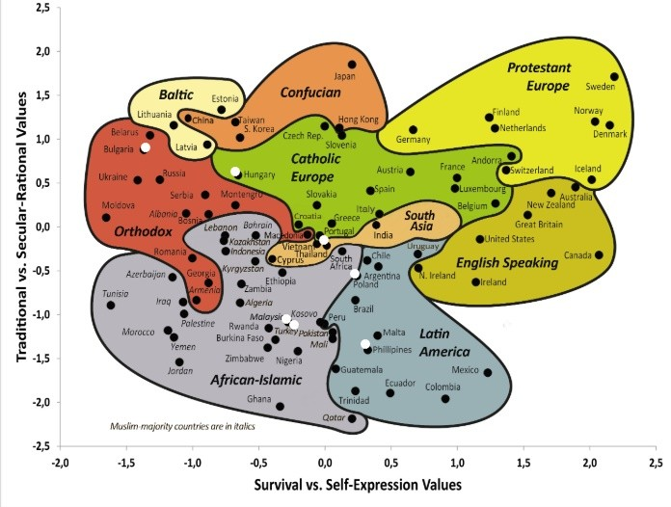
Inglehart–Welzel Cultural Map [Online image]. (2020). World Values Survey. Findings and insights. http://www.worldvaluessurvey.org/WVSContents.jsp?CMSID=Findings

Slide 73
The Change of Cultural Values
The influence on economic and political development
An international network of scientists - Ronald Inglehart and Christian Welzel
Two dimensions reflecting the contrast between the world societies, based on their orientation towards economic growth – Traditional versus Secular-rational values and Survival versus Self-expression values
The broadest research coverage of the main cultural groups with 400,000 respondents in almost 100 countries on all continents
Provides useful information about the changes in people’s beliefs in order to analyse particular social phenomena and trends in different parts of the world.

Slide 74
Hierarchy of Needs
Maslow’s Hierarchy of Needs
After meeting the needs at a particular bottom level, a drive to move up and satisfy the next category of needs is felt.
If some deficiency needs are not satisfied, it is less likely for people to strive for democracy and freedom.
In case survival is not threatened, then self-expression of more democratic values would be more likely to increase social change.
The image shown below, illustrates the two main groups of deficiency and growth needs in the updated Maslow’s structure of 8-stage hierarchy of needs.

Slide 75
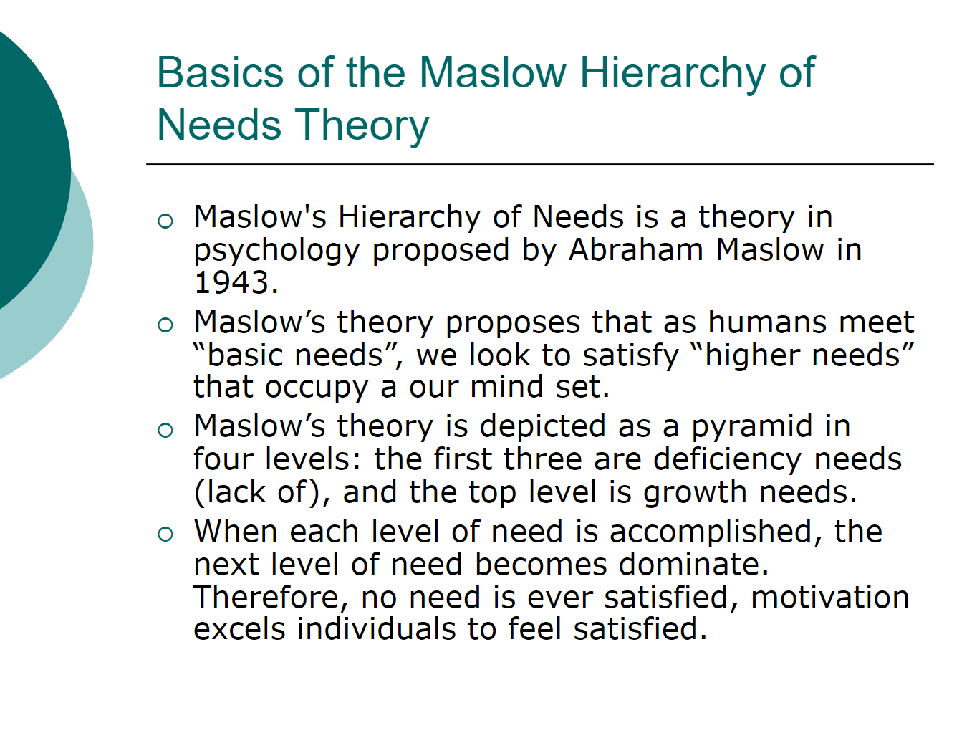

Slide 76
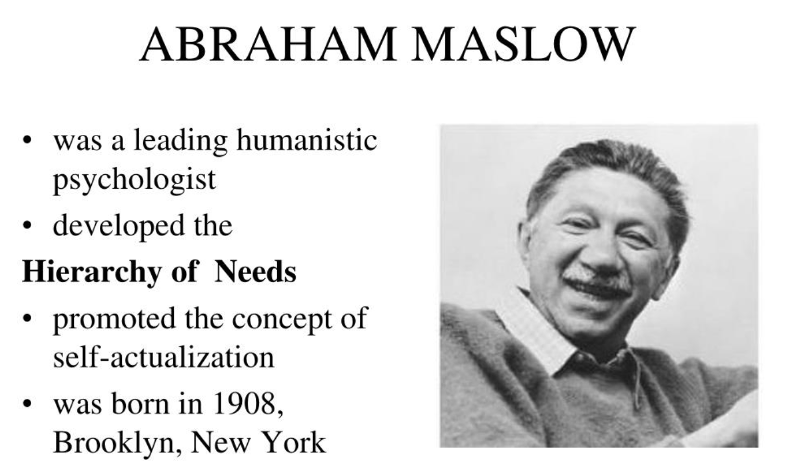

Slide 77
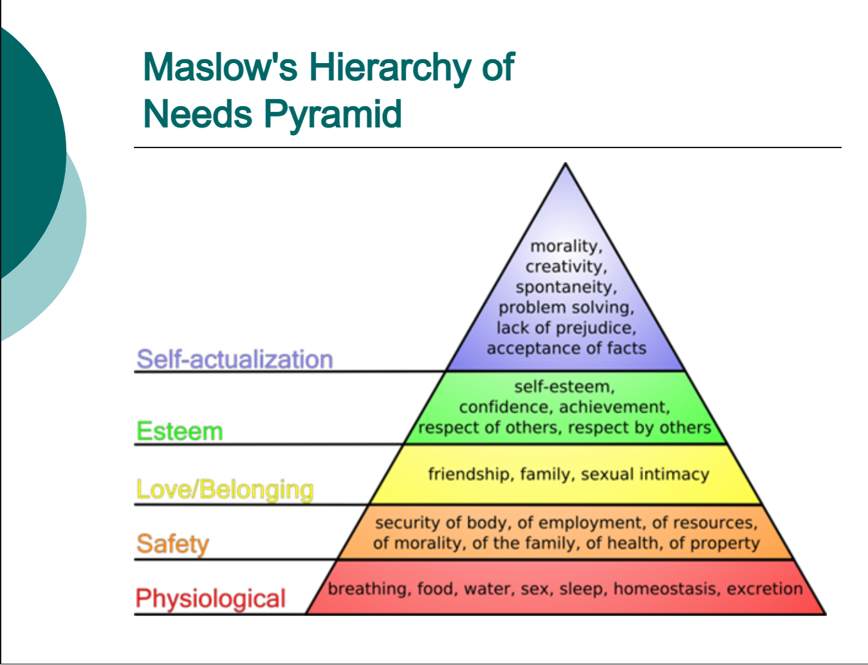


Slide 78
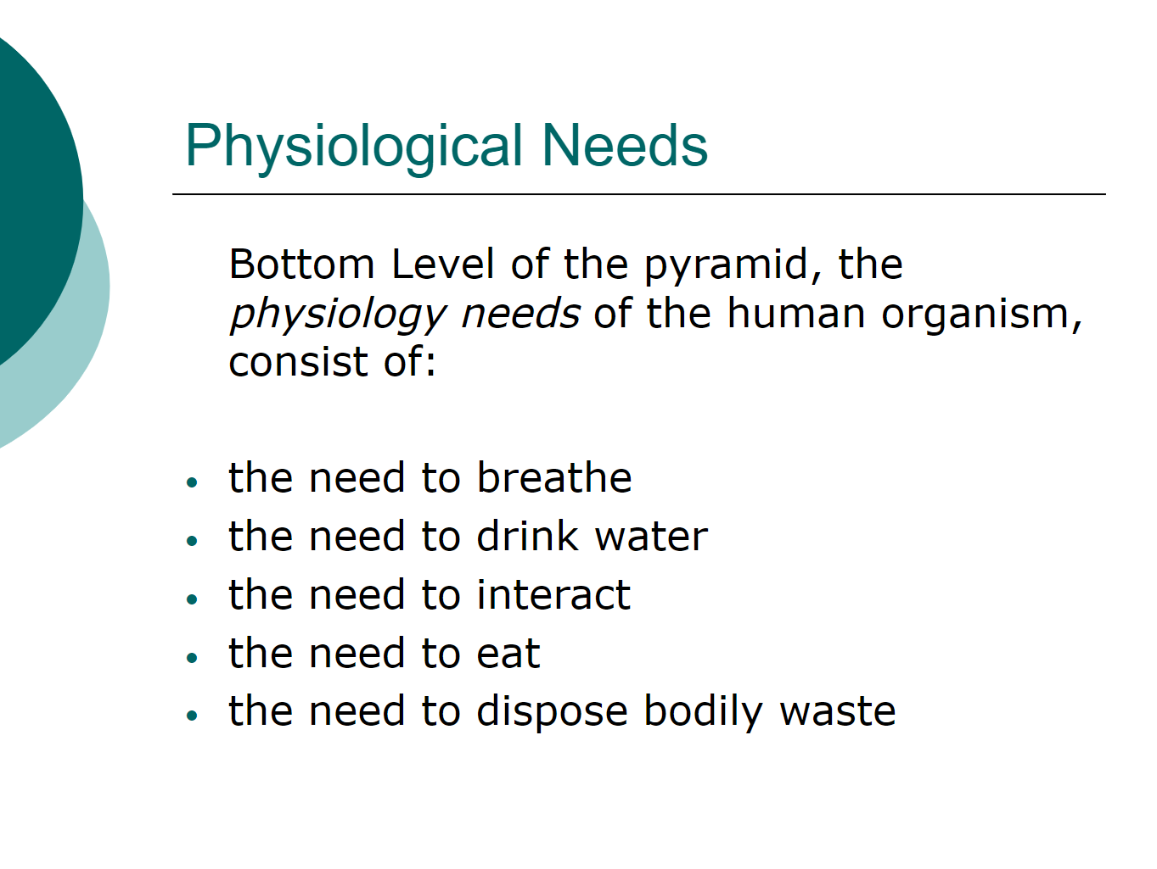
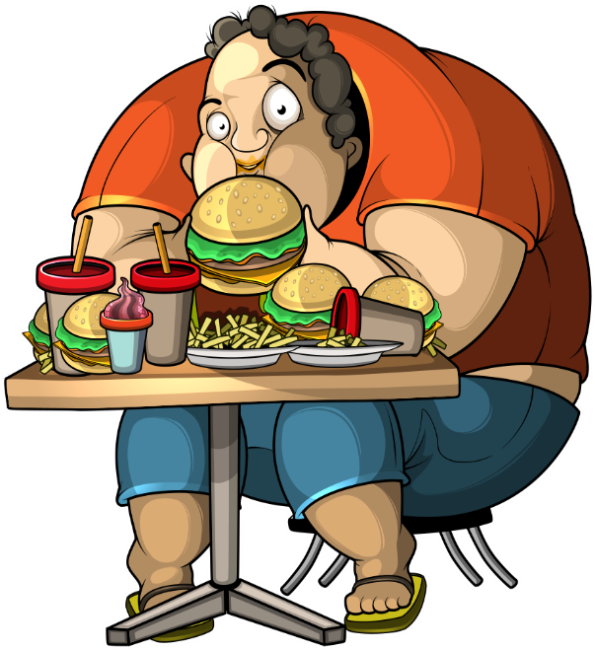


Slide 79
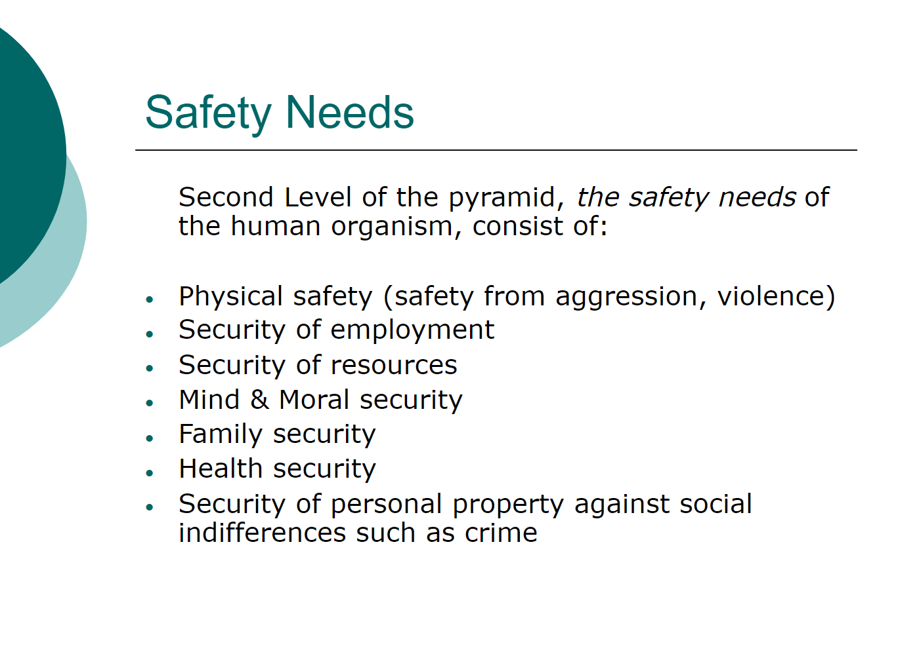


Slide 80
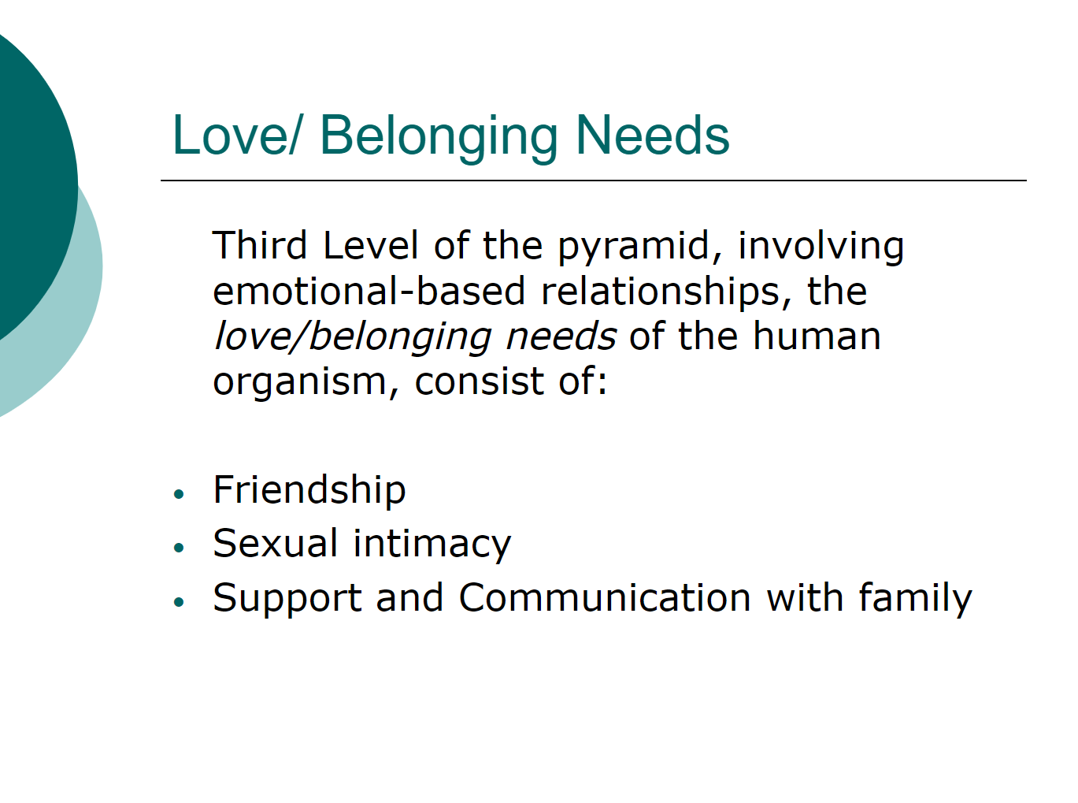


Slide 81
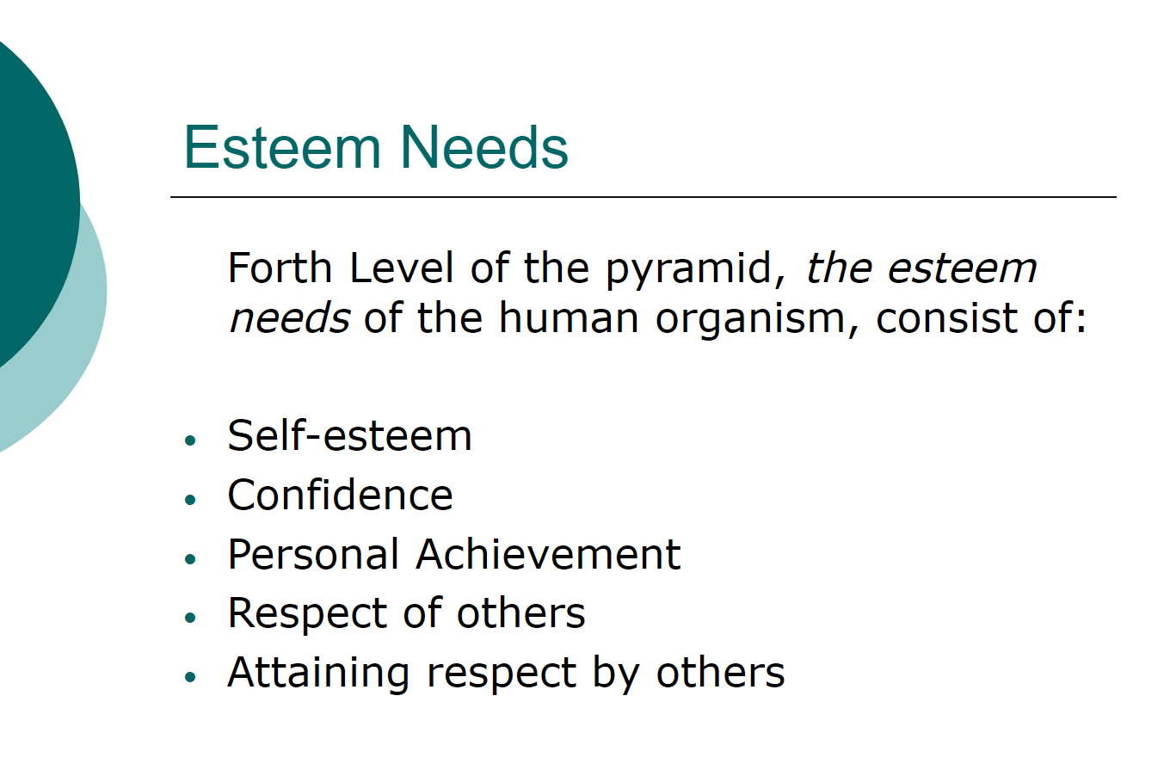


Slide 82
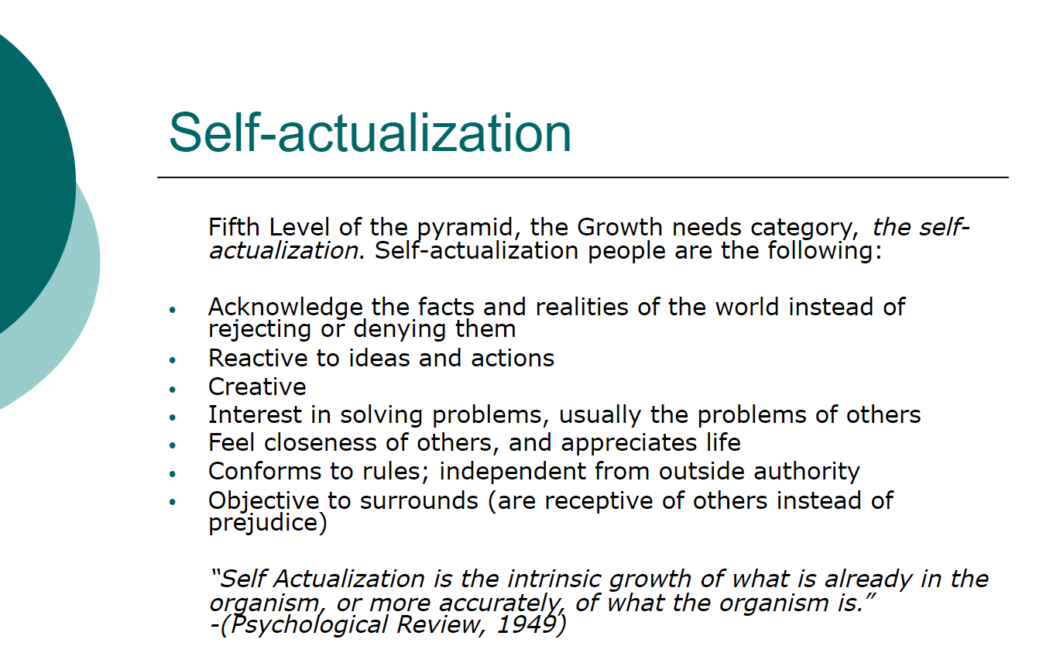


Slide 83
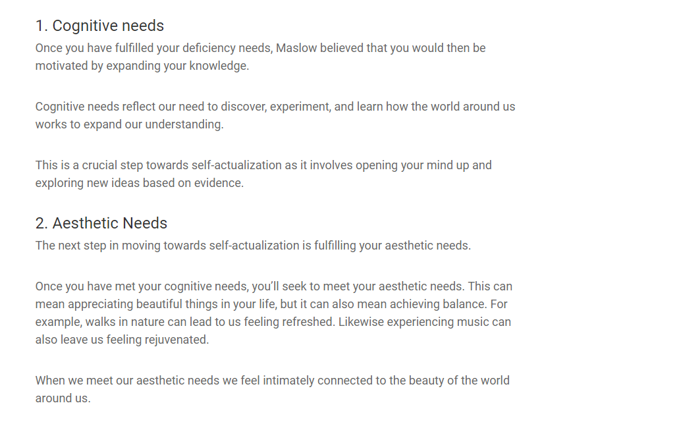



Slide 84

“Transcendence”
“Transcendence refers the very highest and most inclusive or holistic levels of human consciousness, behaving and relating, as ends rather than means, to oneself, to significant others, to human beings in general, to other species, to nature, and to the cosmos (Universe). (Holism in the sense of hierarchical integration is assumed; so also is cognitive and value isomorphism. (Curious to know World Around You)”

Slide 85
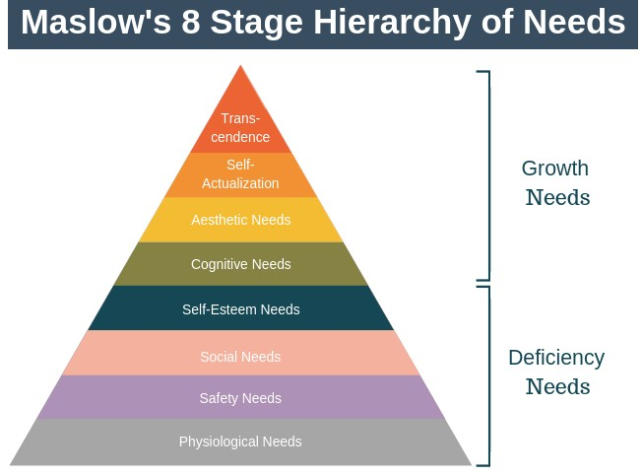
https://youtu.be/zSfmQf5AB_E
Maslow’s Hierarchy of Needs [Online image]. (2020). Expert Program Management. https://expertprogrammanagement.com/2019/06/maslows-hierarchy-of-needs/

Slide 86
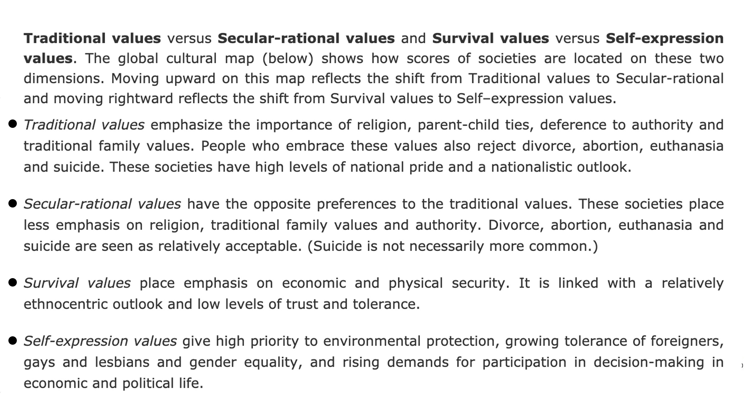

Slide 87
Desire for Freedom
Ronald Inglehart (2007) points out the shift from traditional cultural values to more secular-rational values driven by the industrial revolution with a centralized and standardised authority, followed by the post-industrial development characterised with a trend towards emerging self-expression of people’s desire for freedom.
The social and the political transformation in the contemporary world as a result from two major cultural dimensions.
The Traditional versus Secular-rational dimension measures the difference between the more traditional and religious agrarian societies (Depends Upon Agriculture) and the industrialized societies (Driven by the use of Technology), which share more rational, non-religious (secular) values.
The Survival versus Self-expression dimension focuses on the generational variation of values from physical and economic security to more pronounced expression of growth needs, concerning personal wellbeing.

Slide 88
Mapping the Differences
Through data from six survey waves between 1981 to 2014, The World Values Surveys, accessible at http://www.worldvaluessurvey.org/, provides a global map of the world societies according to the two dimensions.
The vertical axis reflects the movement from Traditional to Secular-rational values and the horizontal axis shows the change from Survival to Self-expressional values.

Slide 89
Inglehart–Welzel Cultural Map [Online image]. (2020). World Values Survey. Findings and insights. http://www.worldvaluessurvey.org/WVSContents.jsp?CMSID=Findings

Slide 90
Examples
Societies that have high scores in Traditional and Survival values: Zimbabwe, Morocco, Jordan, Bangladesh.
Societies with high scores in Traditional and Self-expression values: the U.S., most of Latin America, Ireland.
Societies with high scores in Secular-rational and Survival values: Russia, Bulgaria, Ukraine, Estonia.
Societies with high scores in Secular-rational and Self-expression values: Sweden, Norway, Japan, Benelux, Germany, France, Switzerland, Czech Republic, Slovenia, and some English speaking countries.

Slide 91
The Traditional/Secular-rational Values Dimension
Measures the distance between countries based on the importance of religious values.
Those that are located near the vertical - traditional pole place greater importance on family and connection between parents and children.
Respect to authority and power with higher level of national pride and ethnocentric views of own nation seem to be shared by members of more traditional cultures.
Divorce, abortion and suicide are not accepted.
Secular-rational values dimension measures the opposite preferences.

Slide 92
Some examples from the World Values Survey Findings and Insights available at http://www.worldvaluessurvey.org/WVSContents.jsp
High scores in Traditional and Survival values: Zimbabwe, Morocco, Jordan, Bangladesh.
High scores in Traditional and Self-expression values: the U.S., most of Latin America, Ireland.
High scores in Secular-rational and Survival values: Russia, Bulgaria, Ukraine, Estonia.
High scores in Secular-rational and Self-expression values: Sweden, Norway, Japan, Benelux, Germany, France, Switzerland, Czech Republic, Slovenia, and some English speaking countries.

Slide 93
Human Empowerment
In a knowledge society survival is more secure, therefore quality of life and self- expression become a priority. Issues related to the protection of global environment and equality of genders, tolerance to the otherness, personal initiative and social responsibility are raised.
The shift from survival to self-expressive values involves also a change in educating and raising children work, which facilitates attitudes of trust and tolerance with an emphasis on individual freedom and more active social orientation (Welzel & Inglehart, 2008).
Human empowerment as a consequence of democratic freedoms, self-expression values, and action resources. Democratic freedoms are closely linked to human rights allowing for active participation in social life. Self-expression works on the level of motivation to control our own lives and action resources are meant to develop people’s skills and abilities to organise their lives.

Slide 94
The Environmental Model of Human Empowerment.
The Human Empowerment Triad Effective democratic freedoms contribute significantly to empower people. But they are not the entire story. Instead, as Figure below indicates, human empowerment is a triad consisting of (1) democratic freedoms, (2) self-expression values, and (3) action resources. Each of these three ingredients empowers people on a different level. Democratic freedoms empower people on the level of entitlements, granting people the civil and political rights that allow them to govern public life and their private lives. Self-expression values empower people on the level of motivations in making people willing to govern their lives. Action resources empower people on the level of capabilities, equipping people with the means, skills, and opportunities that enable them to govern their lives. Together these three elements complete human empowerment as a whole.

Slide 95
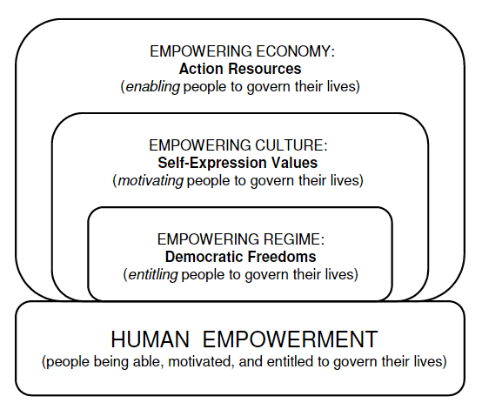
The Environmental Model of Human Empowerment. Welzel, C., & Inglehart, R. (2008,
p. 4). Democracy as Human Empowerment: The Role of Ordinary People in the Emergence and Survival of Democracy. UC Irvine: Center for the Study of Democracy. Retrieved from https://escholarship.org/uc/item/3tj7c4bb

Slide 96
Economic Growth and Self-Expression
Human development seems to be linked to the economic resources available to people through economic growth and to the establishment of more democratic institutions.
These come as a result from increased values of self-expression not only in established democratic societies but also in more autocratic societies.
Globalisation contributes for the spread of self-expression values, which according to the scholars may cause a shift to social liberalization (Abortion and divorce) within the next 20 years.

Slide 97
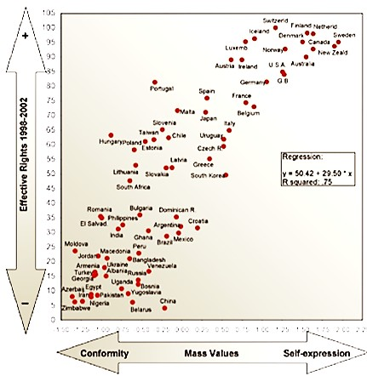
The WVS Correlation between Self-Expression Values and Democratic Institutions
The correlation between mass self-expression values and democratic institutions. Inglehart (n.d.).
Values change the world. World Values Survey. www.iffs.se › media › wvs-brochure- web

Slide 98
Convergence of Cultural Values?
A rise to the global exchange of goods, flow of capital and access to the same sources of information for the mass population around the world
The question about the possible convergence of cultural values in a world without borders - Will societies become less ethnocentric, less traditional and more tolerant to otherness?
The WVS findings do not show significant evidence of values convergence.
The change in attitudes to gender, and family for example are obvious, however the trend is seen as a parallel process in all countries, therefore convergence is not likely to occur.
In summary, considerable transformation of values cannot be achieved through democratic orientation only. A deeper change at individual level is needed in order to accept gender equality.

Slide 99
The Change of Religious Beliefs
Globalisation facilitates cultural diversity which generates growth of religious engagement and positive views of the impact of religion on political decisions.
Two dimensions of global modernisation were assumed to influence religious beliefs in different ways, consequently leading to decline or growth.
For 98% of the Indonesians religion is very important in their lives while in China only three percent considered religion very important.
Both these were supported by the WVS data, illustrating an opposite effect on religion, therefore any conclusive statements should be avoided.

Slide 100
Happiness and Life Satisfaction
From 1981 to 2007 happiness rose in 45 of the 52 countries for which long-term data are available.
Economic development and democratic movement have increased the extent to which people perceive freedom of choice, which in turn has led to higher levels of happiness around the world.
The popular statistics website Nationmaster publishes a simplified world happiness scale derived from the WVS data, available at https://www.nationmaster.com/country- info/profiles
One of the most expressed trends measured by the WVS was the steep decline in happiness experienced in Russia and many other ex-communist countries during the 1990s.
https://ourworldindata.org/happiness-and-life-satisfaction

Slide 101
The Most Important Benefits from the WVS Project
The importance of the WVS project is related to the empirical evidence (Experimental) of social and economic transformation of values at the individual level which is not yet thoroughly studied and adequately understood worldwide. In general, knowledge of WVS findings can facilitate business and political decision making in order to deal with the change of cultural values.
A catalogue with a detailed list of the key WVS findings is available at http://www.worldvaluessurvey.org/WVSContents.jsp
For a deeper understanding, an interesting presentation by Dr. Welzel about the WVS research results can be watched on Ted Talks at www.youtube.com/watch?v=qesLGw23_zQ.

Slide 102
Self-study
(instructions below the questionnaire)
For each of the following, indicate how important it is in your life. Would you say it is :
Very important Rather important Not very important Not at all important
 | 1 | 2 | 3 | 4
V4. Family | 1 | 2 | 3 | 4
V5. Friends | 1 | 2 | 3 | 4
V6. Leisure time | 1 | 2 | 3 | 4
V7. Politics | 1 | 2 | 3 | 4
V8. Work | 1 | 2 | 3 | 4
V9. Religion | 1 | 2 | 3 | 4

Slide 103
V10. Taking all things together, would you say you are:
Very happy
Rather happy 3 Not very happy
4 Not at all happy

Slide 104
Here is a list of qualities that children can be encouraged to learn at home. Which, if any, do you consider to be especially important? Please choose up to five.
V12. Independence V13. Hard work
V14. Feeling of responsibility V15. Imagination
V16. Tolerance and respect for other people V17. Thrift, saving money and things
V18. Determination, perseverance V19. Religious faith
V20. Unselfishness V21. Obedience
V22. Self-expression.

Slide 105
V23. All things considered, how satisfied are you with your life as a whole these days?
1 means you are “completely dissatisfied” and 10 means you are “completely satisfied”
Where would you put your satisfaction with your life as a whole? Circle the appropriate number.
Completely dissatisfied Completely satisfied
1 2 3 4 5 6 7 8 9 10
V24. Generally speaking, would you say that most people can be trusted or that you need to be very careful in dealing with people?
1 Most people can be trusted. 2 Need to be very careful.
WV6 Official questionnaire. WVS 2010-2012 Wave, revised master, June 2012. Retrieved from http://www.worldvaluessurvey.org/WVSDocumentationWV6.jsp

Slide 106
Instructions
Answer the questions.
Interview some friends or family members (possibly from different age groups)
Compare your answers and those of your relatives with the online WVS data about your country available at http://www.worldvaluessurvey.org/WVSOnline.jsp
Different countries can be found in different waves. Check the list of countries in each wave. Identify your country. Check the box and click “Next”. Select a variable from your mini questionnaire (V4, V5, V6 …).
Click “Show”. Compare your own answers and those of your relatives with the data from the WVS.
Which categories of your answers are similar to or different from those of your friends, family and fellow citizens? Are there any differences between the age groups? Did you notice any specific cultural values which are shared by you, your family and your fellow citizens? How can these common aspects of your culture affect your communication with people from other countries, such as England, The Netherlands, France, Russia, Egypt, China, Brazil, and Nigeria?

Slide 107
References
Esmer, Y., & Pettersson, T. (2007). Measuring and mapping cultures : 25 years of comparative value surveys (International studies in sociology and social anthropology, v. 104).
Inglehart, R. (2007). Mapping global values. International Studies in Sociology and Social Anthropology, 104, 11-32.
Inglehart (n.d.).Values change the world. World Values Survey. www.iffs.se › media › wvs-brochure-web
Inglehart–Welzel Cultural Map. (2020). World Values Survey. Findings and insights. http://www.worldvaluessurvey.org/WVSContents.jsp?CMSID=Findings

Slide 108
Inglehart, R., C. Haerpfer, A. Moreno, C. Welzel, K. Kizilova, J. Diez-Medrano, M. Lagos, P. Norris, E. Ponarin & B. Puranen et al. (eds.). 2014. World Values Survey: All Rounds - Country-Pooled Datafile Version: http://www.worldvaluessurvey.org/WVSDocumentationWVL.jsp. Madrid: JD Systems Institute.
Maslow’s Hierarchy of Needs. (2020). Expert Program Management. https://expertprogrammanagement.com/2019/06/maslows-hierarchy-of-needs/
NationMaster: Country Profiles. (2020). Copyright NationMaster.com 2003-2020. Retrieved from https://www.nationmaster.com/country-info/profiles/
TEDx Talks. “Moral Progress: Expanding the Human Mind | Dr. Christian Welzel | TEDxLeuphanaUniversityLüneburg.” YouTube, YouTube, 17 Jan. 2017, www.youtube.com/watch?v=qesLGw23_zQ.
Welzel, C., & Inglehart, R. (2008). Democracy as Human Empowerment: The Role of Ordinary People in the Emergence and Survival of Democracy.

